Slide 1
Lecture 4: Control Statements – Part I
Class page: https://github.com/tsung-wei-huang/cs1410-40
Dr. Tsung-Wei Huang
Department of Electrical and Computer Engineering
University of Utah, Salt Lake City, UT
Notes:
Morning everyone
Today we are looking into control flow in C++.

Slide 2
Announcement
TODO: ask students to email PA with a “fixed-format” subject

Slide 3
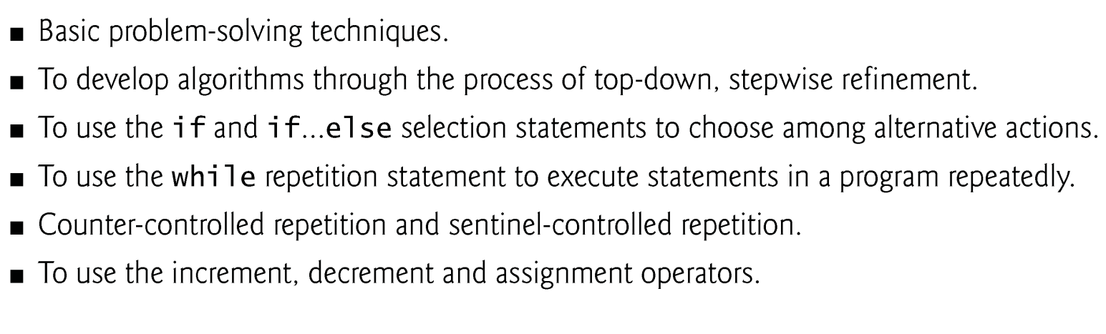
Learning Objective
Notes:
We will learn basic problem-solving techniques to develop algorithms … (explain)

Slide 4
Introduction
Before writing a program to solve a problem, we must have a thorough understanding of the problem and a carefully planned approach to solving it.
When writing a program, we must also understand the types of building blocks that are available and employ proven program construction techniques.
We use several lectures to discuss these issues as we present the theory and principles of structured programming.

Slide 5
Algorithm
Any solvable computing problem can be solved by the execution of a series of actions in a specific order.
An algorithm is procedure for solving a problem in terms of
the actions to execute and
the order in which the actions execute
Specifying the order in which statements (actions) execute in a computer program is called program control.
We investigate program control flow using C++’s control statements.

Slide 6
Pseudocode
Pseudocode (or “fake” code) is an artificial and informal language that helps you develop algorithms.
Similar to everyday English
Convenient and user friendly.
Helps you “think out” a program before attempting to write it.
Carefully prepared pseudocode can easily be converted to a corresponding C++ program.
Normally describes only executable statements.
Declarations are not executable statements.
Notes:
Algorithm is a concept that describes the idea of your solution. The way we describe an algorithm is to use Pseudocode.

Slide 7
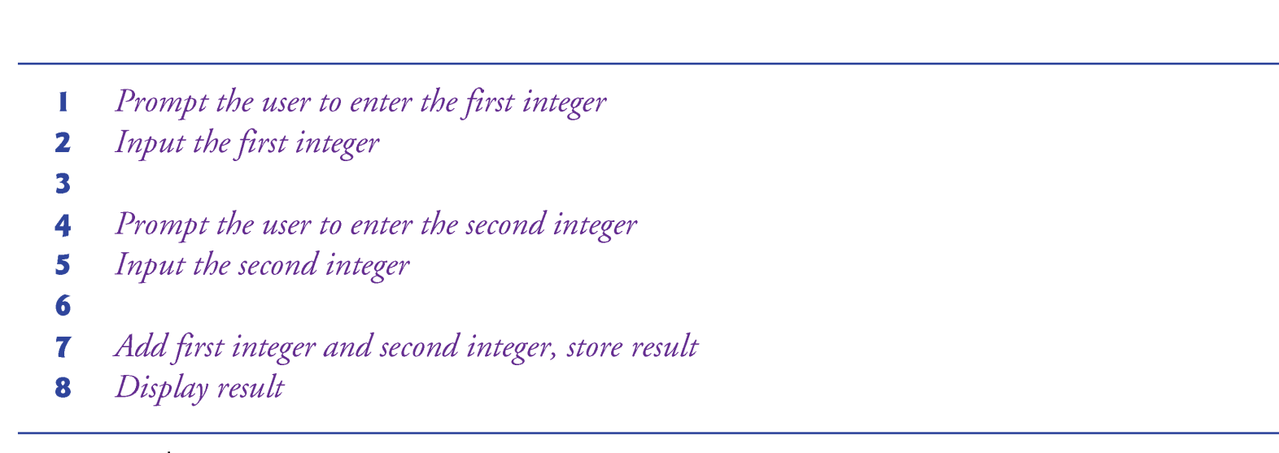
Pseudocode Example
Notes:
This is an pseudocode example that demonstrates the adding integers example we presented in the previous lecture. (explain ... )

Slide 8
Control Structure
Normally, statements in a program execute one after the other in the order in which they’re written.
Called sequential execution.
Various C++ statements enable you to specify the next executing statement that is not the next one in sequence.
Called transfer of control.
All programs could be written in terms of only three control structures (referred as “control statements”)
the sequence structure
the selection structure and
the repetition structure

Slide 9
Control Structure (cont’d)
C++ provides three types of selection statements
The if selection statement: (single selection)
The condition is true: perform the following action
The condition is false: skip the action
The if…else selection statement: (double selection)
The condition is true: perform the following action
The condition is false: perform a different action
The switch selection statement: (multiple selection)
Perform one of many different actions, depending on the value of selection expression.

Slide 10
Control Structure (cont’d)
C++ provides three repetition statements (also called looping statements) for performing statements repeatedly.
These are the while, do…while and for statements.
The while and for statements perform the action (or group of actions) in their bodies zero or more times.
The do…while statement performs the action (or group of actions) in its body at least once.

Slide 11
Control Structure (cont’d)
Each of the words if, else, switch, while, do and for is a C++ keyword.
Keywords must not be used as identifiers, such as variable names.

Slide 12
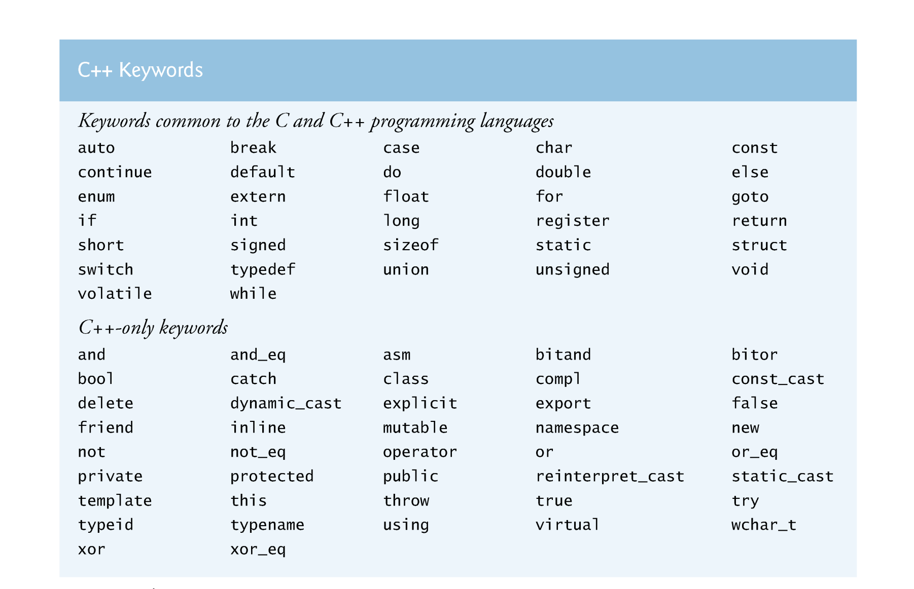
Control Structure Keywords
Notes:
This slides summarize the keywords for control structure. There are many other keywords that allow you to do multiple kinds of control flow and each of the keyword has its own specific meaning. Among these keywords, the while statement, do..while statement, and for statement are the three mostly used control structure.

Slide 13
Control Structure (cont’d)
Each program combines control statements as appropriate for the algorithm the program implements.
C++ control statements are single-entry/single-exit
Control statements are attached to one another by connecting the exit point of one to the entry point of the next.
Called control-statement stacking
Another way to connect control statements is containing one control statement inside another one
Called control-statement nesting

Slide 14
if Selection Statement
The following pseudocode determines whether “student’s grade is greater than or equal to 60” is true or false.
If student’s grade is greater than or equal to 60 Print “Passed”
If true, “Passed” is printed and the next pseudocode statement in order is “performed”.
If false, the print statement is ignored and the next pseudocode statement in order is performed.
The indentation of the second line is optional, but it’s recommended because it emphasizes the inherent structure of structured programs.
Notes:
Let's look at the single selection statement, if.

Slide 15
if Selection Statement
The preceding pseudocode can be written in C++ as
if ( grade >= 60 ) cout << "Passed";
The diamond (decision symbol) indicates that a decision is to be made.
The workflow will continue along a path determined by the symbol’s associated guard conditions, which can be true or false.
If a guard condition is true, the workflow enters the action state to which that transition arrow points.
grade >= 60?
Yes
No
Notes:
So the previous pseudocode can be written in C++ as this:

Slide 16
if Selection Statement
If the expression evaluates to zero, it’s treated as false; if the expression evaluates to nonzero, it’s treated as true.
C++ provides the data type bool for variables that can hold only the values true and false—each of these is a C++ keyword.
For compatibility with earlier versions of C, which used integers for Boolean values, the bool value true also can be represented by any nonzero value

Slide 17
if…else Double-Selection Statement
if…else double-selection statement
specifies an action to perform when the condition is true and a different action to perform when the condition is false.
The following pseudocode prints “Passed” if the student’s grade is greater than or equal to 60, or “Failed” if the student’s grade is less than 60.
If student’s grade is greater than or equal to 60 Print “Passed” Else Print “Failed”
In either case, after printing occurs, the next pseudocode statement in sequence is “performed.”
Notes:
We have seen how to use a single if statement to enable a single selection. What is I want to do double selection, if something is true, I am going to do A, or I do B. This is double selection. C++ allows you to define double selection using if else statement.
If...else statement specifies an action to perform ... (explained)

Slide 18
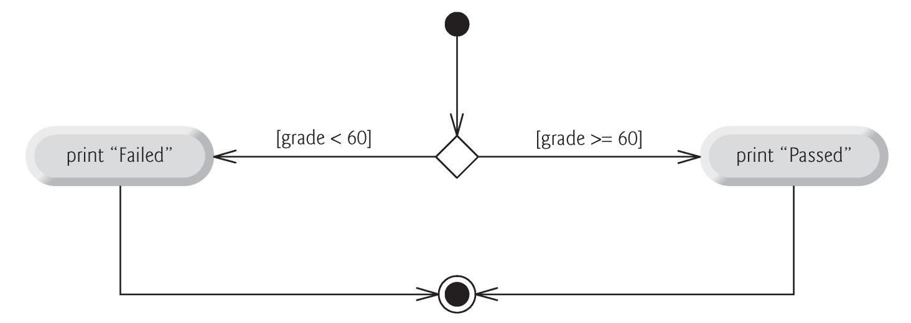
if…else Double-Selection Statement
The preceding pseudocode If…Else statement can be written in C++ as
if ( grade >= 60 ) cout << "Passed"; else cout << "Failed";
The control flow of if…else is shown as follows.
Notes:
In terms of real code, it looks like this. I have a variable, grade, to represent the value of the grade. If ...

Slide 19
if…else Double-Selection Statement
1. (grade>=60) ? cout << “Passed” : cout << “Failed” ;
2. final = (grade>=50) ? 60 : grade ;
Conditional operator (?:)
Closely related to the if…else statement.
C++’s only ternary operator—it takes three operands.
The first operand is a condition
The second operand is the value if the condition is true
The third operand is the value if the condition is false.
The values in a conditional expression can be actions.
Notes:
Indeed, if...else double selection statement can be simplified to the following; You can write a single line using the "question mark" and the "colon mark" to describe a if...else double selection. The syntax is like this: (exaplain ... )

Slide 20
if…else Double-Selection Statement
Nested if…else statements test for multiple cases by placing if…else selection statements inside other ones.
If student’s grade is greater than or equal to 90 Print “A” Else If student’s grade is greater than or equal to 80 Print “B” Else If student’s grade is greater than or equal to 70 Print “C” Else If student’s grade is greater than or equal to 60 Print “D” Else Print “F”
Notes:
With this simple if...else double selection statement, you can start building things with complex control flow. For example, you can use nested if...else statements test for multiple cases by placing ...

Slide 21
if…else Double-Selection Statement
The pseudo code can rewritten in C++ as follows.
if ( studentGrade >= 90 ) // 90 and above gets "A" cout << "A"; else if ( studentGrade >= 80 ) // 80-89 gets "B" cout << "B"; else if ( studentGrade >= 70 ) // 70-79 gets "C" cout << "C"; else if ( studentGrade >= 60 ) // 60-69 gets "D" cout << "D"; else // less than 60 gets "F" cout << "F";
If studentGrade is greater than or equal to 90, only the output statement after the first test executes.
Skip the other branches
Notes:
In terms of C++ code, it looks like this.

Slide 22
if…else Double-Selection Statement
Most write the preceding if…else statement as
if ( studentGrade >= 90 ) // 90 and above gets "A" cout << "A"; else if ( studentGrade >= 80 ) // 80-89 gets "B" cout << "B"; else if ( studentGrade >= 70 ) // 70-79 gets "C" cout << "C"; else if ( studentGrade >= 60 ) // 60-69 gets "D" cout << "D"; else // less than 60 gets "F" cout << "F";
The two forms are identical except for the spacing and indentation, which the compiler ignores.
The latter form is popular because it avoids deep indentation.
Notes:
In fact, this nested if-else double selection block can be simplified by another C++ keyword else if. Using else if lets you describe a nested condition in which each condition is disjoint with each other. For example, here I write ...

Slide 23
if…else Double-Selection Statement
The C++ compiler always associates an if or else with the immediately preceding actions.
This behavior can lead to the dangling-else problem.
if ( x > 5 ) if ( y > 5 ) cout << "x and y are > 5"; else cout << "x is <= 5";
What’s the difference with a pair of braces ({}) ?
if ( x > 5 ) { if ( y > 5 ) cout << "x and y are > 5"; } else cout << "x is <= 5";

Slide 24
if…else Double-Selection Statement
The if selection statement expects only one statement in its body.
Similarly, the if and else parts of an if…else statement each expect only one body statement.
To include several statements in the body of an if or in either part of an if…else, enclose the statements in braces ({ and }).
A set of statements contained within a pair of braces is called a compound statement or a block.

Slide 25
if…else Double-Selection Statement
A block {} can be placed anywhere in a program that a single statement can be placed
Forgetting one or both of the braces that delimit a block can lead to syntax errors or logic errors in a program
{ int a; // missing ‘}’
ing b; } // missing ‘{’
Always putting the braces in an if…else statement (or any control statement) helps prevent their accidental omission, especially when adding statements to an if or else clause at a later time.

Slide 26
if…else Double-Selection Statement
Just as a block can be placed anywhere a single statement can be placed, it’s also possible to have no statement at all
—called a null statement (or an empty statement).
{
; // empty statement
}
The null statement is represented by placing a semicolon (;) where a statement would normally be.

Slide 27
while Repetition Statement
A repetition statement (also called a looping statement) allows you to repeat an action while some condition remains true.
While there are more items on my shopping list Purchase next item and cross it off my list
Consider a program segment designed to find the first power of 3 larger than 100.
Suppose the integer variable product has been initialized to 3.
When the following while repetition statement finishes executing, product contains the result:
int product = 3; while ( product <= 100 ) { product = 3 * product;
cout << product << ‘\n’;
}
Notes:
Let’s move on to the next big topic of control flow – the while repetition statement. A repetition statement, also called a looping statement, allows you to repeat an action while some condition remains true. It looks like this, while there are more items … (explain)

Slide 28
Avoid Writing Infinite Loop!
Not providing, in the body of a while statement, an action that eventually causes the condition in the while to become false normally results in a logic error called an “in-finite” loop, in which repetition never stops!
int product = 3; while ( product >= 3 ) { product = 3;
}
Infinite loop makes a program appear to hang or freeze if the loop body does not contain statements that interact with the user
This is a very frequently used method to attack your computer (computer virus)

Slide 29
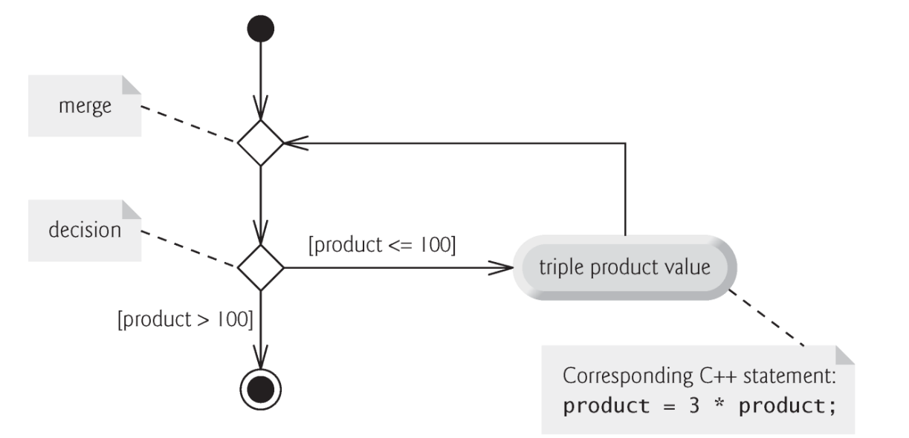
Diagram of the While statement
While statement can be represented by a merge symbol
The merge symbol joins the transitions from the initial state and from the action state
Determine whether the loop should begin (or continue) executing
A merge symbol has two or more input transition arrows and only one output transition arrow
Unlike the decision symbol, the merge symbol does not have a counterpart in C++ code

Slide 30
Formulating Algorithms: Counter-Controlled Repetition
Consider the following problem statement:
A class of 10 students taking a quiz.
The grades (integers in the range 0 to 100) are available to you.
Calculate and display the total of all student grades and the class average on the quiz.
We use counter-controlled repetition to input the 10 grades one by one.
This technique uses a variable called a counter to control the number of times a group of statements will execute (also known as the number of iterations of the loop).
Often called definite repetition because the number of repetitions is known before the loop begins executing.

Slide 31
Formulating Algorithms: Counter-Controlled Repetition
A total is a variable used to accumulate the sum of several values.
A counter is a variable used to count—in this case, the grade counter indicates which of the 10 grades is about to be entered by the user.
The class average is equal to the sum of the grades (total) divided by the number of students (10).
Dividing two integers results in integer division—any fractional part of the calculation is lost (i.e., truncated).

Slide 32
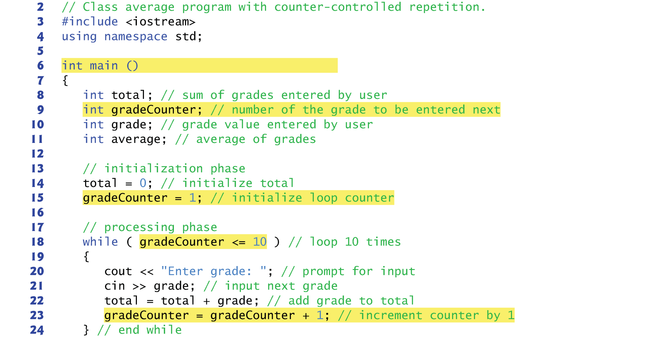
Formulating Algorithms: Counter-Controlled Repetition

Slide 33
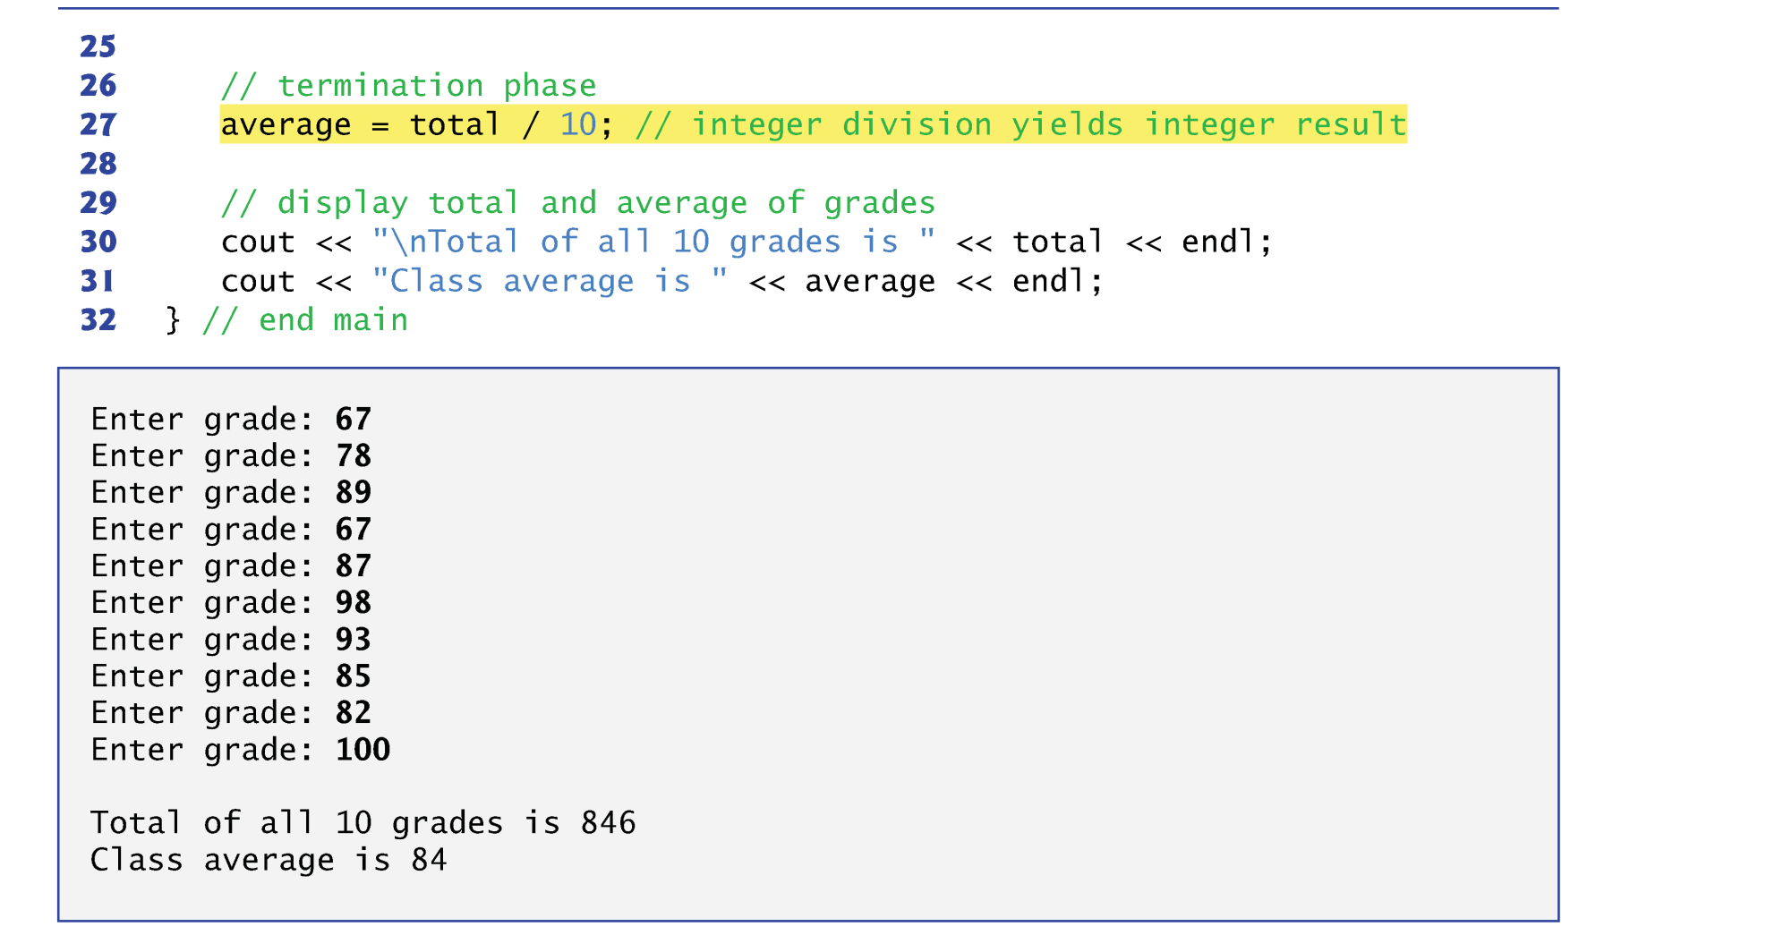
Formulating Algorithms: Counter-Controlled Repetition

Slide 34
Example from Lecture 1
Find a power of a number
Input: a, b (1 < a, b < 2147483647)
Output: x = a^{b}
a=3, b=4, x=3⁴=81
a=2, b=5, x=2⁵=32
Assume you can only do multiplication one at a time
Naïve method
2¹⁶ = 2*2*2*2*2*2*…*2 total 15 calculations
Can we do better?
Notes:
With this repetition control-flow statement, we can start implementing something very interesting. Let’s refresh our memory on this example from lecture1. Remember that in the lecture 1, I used this finding a power of a number to tell you it doesn’t really matter which language you learn first, because what really matters is the logic thinking you define to solve a problem. We are doing to look at this example again.

Slide 35
Divide and Conquer
Naïve method
2¹⁶ = 2*2*2*2*2*2*…*2 total 15 calculations
A better way as follows:
2¹⁶ = 2⁸ * 2⁸
2⁸ = 2⁴ * 2⁴
2⁴ = 2² * 2²
2² = 2 * 2
We need only 4 calculations!!!
Notes:
Turns out there is a better way to solve this problem. And this is the most basic yet the most important, widely applied technique in computer programming: Divide and Conquer.

Slide 36
How Efficient is it to Compute a^{b}?
Naïve method
# calculations: linear to b
Divide and Conquer
# calculations: log₂(b)
Let’s say n = 2147483648
Naïve method takes 2147483647 calculations (~10-30s)
Divide and Conquer takes only 31 calculations (~1us)
10000000x faster!
Indeed, this is a Goo___ interview question
Notes:
How efficient is it to compute the general case a to the b?

Slide 37
Practice
Write a program that asks the user to type in two integer number a and b; your program then computes the value x = a^{b} and print the result
For simplicity, don’t worry about overflow now
use while statement to manipulate the counter
Compare the two versions
Linear time
Log time
Both versions should output the same value
Do you see speed difference when b is large?

Slide 38
Summary
Control flow
Algorithm and pseudocode
If..else statement
while repetition statement
Programming Assignment 2 is out
Due 9/9 by class time
Email your solution to your LAB section TA
Notes:
u1306576@umail.utah.edu;u1100840@utah.edu;u1231201@utah.edu;u1059119@utah.edu;u1277271@utah.edu;u1279042@utah.edu;u1288871@utah.edu;u1162987@utah.edu;u1149181@utah.edu;u1034348@utah.edu;u1274730@utah.edu;u1309216@utah.edu;u1307344@utah.edu;u1054050@utah.edu;u0906668@utah.edu;u1020513@utah.edu;u1046844@utah.edu;u0934438@utah.edu;u1028034@utah.edu;u1218276@utah.edu;u1205315@utah.edu;u1235021@utah.edu;u0613876@utah.edu;u1194598@utah.edu;u0800167@utah.edu;u1100383@utah.edu;u1313270@utah.edu;u1170639@utah.edu;u1233102@utah.edu;u0441877@utah.edu;u1306569@utah.edu;u1117469@utah.edu;u1053605@utah.edu;u1186007@utah.edu;u1117512@utah.edu;u1015229@utah.edu;u1322203@utah.edu;u1030352@utah.edu;u1030406@utah.edu;u1298265@utah.edu;u1309248@utah.edu;u1134903@utah.edu;u1080280@utah.edu;u1184264@utah.edu;u1255151@utah.edu;u0726957@utah.edu;u1174177@utah.edu;u1165266@utah.edu;u1201859@utah.edu;u1169721@utah.edu;u1337151@utah.edu;u1025911@utah.edu;u1307883@utah.edu;

